Slide 1
PLAGIARISM CHECKER
A DETECTION SYSTEM USING TECH STACK OF PYTHON, DATA SCIENCE & MACHINE LEARNING.

Slide 2
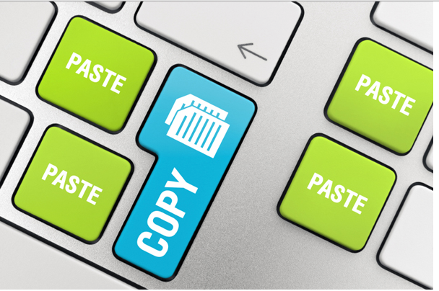
PLAGIARISM DETECTION SYSTEM:-
Plagiarism is defined as to take or copy some work and present it has one’s own work. Plagiarism affects the education quality of the students and thereby reduce the economic status of the country. Plagiarism is done by paraphrased works and the similarities between keywords and change of sentences from one form to other form, which could be identified using plagiarism detection system. This plagiarism detector measures the similar text that matches and detects plagiarism. Internet has changed the student’s life and also has changed their learning style. It allows the students to get deeper in the approach towards learning and making their task easier. But in this pandemic online teaching plays a vital role in which this detection system can be very helpful for the professors in the evaluation process.

Slide 3
LIBRARIES USED FOR THE SYSTEM:-
difflib (SequenceMatcher)
re
nltk (N-gram Language Model)
plotely.graph_objects
scipy.ndimage (gaussian_filter)
os
docx2txt & doc2txt
textract & pypdf2
random
Copyleaks API

Slide 4
SYSTEM DESIGNED FOR LOCALLY STORED FILES:-
Using split text to split name and extension of file, type of file is identified and based on that, the file is read using the corresponding libraries to start for comparison.
Using SequenceMatcher module from difflib which is used to compare the any datatype sequence so two files are compared for plagiarism i.e., similarity to get the percentage as an output.
To get visual representation of plagiarism detection N-gram language model is created which scores words based on the preceding window of context. To implement it nltk library is used which provide different modules for steps involved in it.
In the training process first all the punctuation and formatting are removed from file provided after that word is tokenize i.e., separating in individual then using .ngrams division is done in the group (N=4 i.e., N-grams and N-1=3 i.e., Group of words).

Slide 5
Testing set is defined as similar process is repeated on it.
To visualize, plotely and scipy lib is used i.e., to get the heatmap representation. In the map in which width and height is specified and we get per line (K=8 i.e., Words per line) result means probability ranging from 0 to 1 is labelled. Many other functions are used to create the visualization in an effective way.

Slide 6
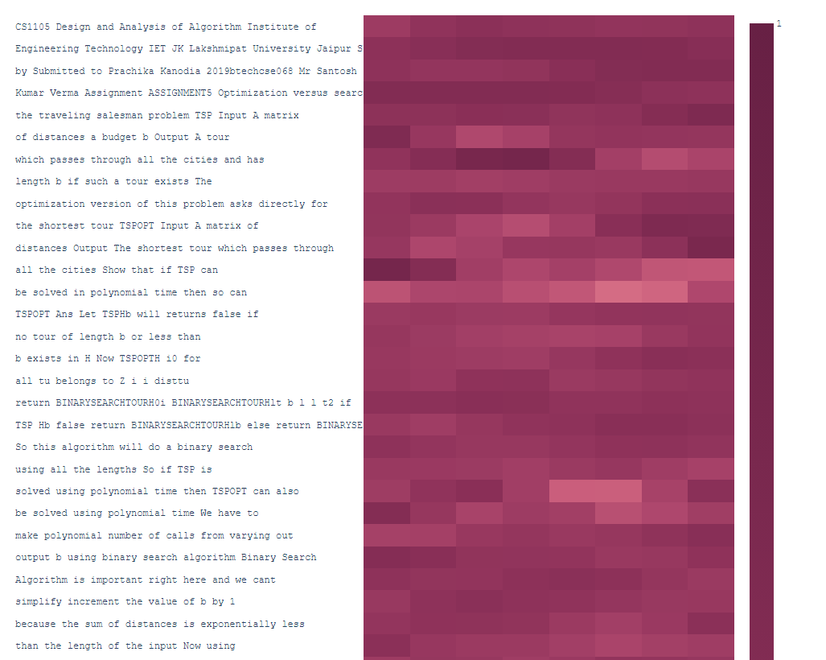
SAMPLE OUTPUT:-
The output is shown in form of heatmaps with dark regions showing higher probability of similarity. Ranging from 0 to1 with 1 being absolute copy.
Each line consists of 8 words and can be altered according to the need. The heatmap is divided into rectangles each representing one word in a line.

Slide 7
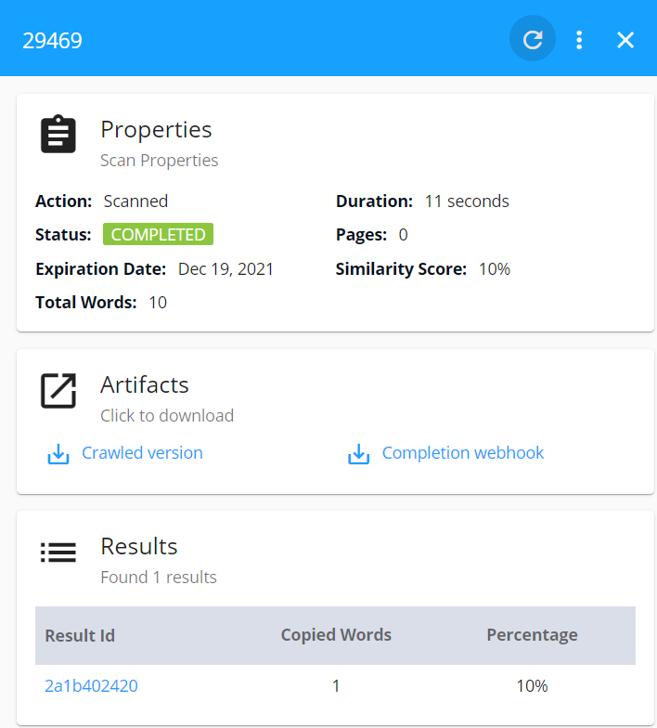
COPYLEAKS API:-
Copyleaks is an open source API which can be integrated with any project for plagiarism detection. To incorporate plagiarism detection over internet sources, this was used.
It gives personalized reports and allows free plagiarism checks over any file type encoded in base 64. It have the ability to detect plagiarism within paraphrased content with the help of its AI capabilities.
The output generated from it shows all information in .json file regarding plagiarism of file from internet.

Slide 8
CONCLUSION AND FUTURE SCOPE:-
We were able to build a simple plagiarism detection software and with the help of advanced API, we were able to incorporate additional features which are currently out of scope of our learnings so far.
This project can be further enhanced with its own system so that the use of external API is reduced. It can also be expanded to check plagiarism in code files rather than just pdfs and docx files.

Slide 9
GitHub Link:- https://github.com/Intern-NetparamTechnologies/Plagrism_Checker
THANK YOU
Prachika Kanodia
(2019BTechCSE068)
J.K.Lakshmipat University, Jaipur
Tanmay Agarwal
(2019BTechCSE053)
J.K.Lakshmipat University, Jaipur

